Slide 1

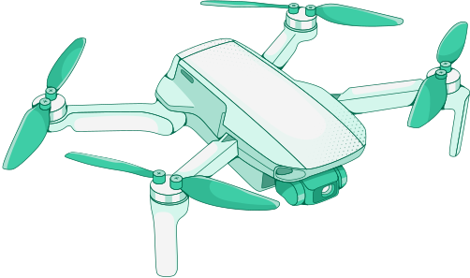

Rescue
Tech System

Slide 2
ABSTRACT
The "RescueTech System" is a game-changing system designed to handle India's crucial concerns in emergency response, traffic management, and environmental monitoring. This system is built on a highly adaptable modular robotics and drone base that can seamlessly transform into a variety of specialized modules. Communication and mapping, traffic control, water quality analysis, environmental monitoring, and disaster response are all included in these modules. Each module is outfitted with cutting-edge sensors, artificial intelligence (AI) algorithms, and powerful communication capabilities, allowing it to excel at doing its assigned tasks as efficiently as possible. The RescueTech System has the potential to transform how India manages crises, transportation congestion, and environmental problems by providing a complete and adaptive solution to improve the country's safety and well-being.

Slide 3

IDEA
The "RescueTech System" is an innovative and adaptable solution designed to tackle India's pressing challenges related to emergency response, traffic management, and environmental monitoring.

Slide 4
SOLUTION
A highly adjustable and flexible modular robotics and drone platform is at the core of this cutting-edge technology. This platform's unique capacity to change itself into a broad variety of specialized components, each customized to tackle certain tasks and obstacles, distinguishes it. These modules cover a wide range of applications, including seamless communication and exact mapping, effective traffic management, careful water quality monitoring, comprehensive environmental surveillance, and speedy catastrophe response.

Slide 5
PROTOTYPE
A functional prototype of the RescueTech System has been developed and rigorously tested in controlled environments. This prototype serves as proof of concept, demonstrating the adaptability, feasibility, and functionality of the core robotics platform and select key modules, such as emergency assistance and traffic management.

Slide 6
TECHNOLOGY STACK
01.
02.
03.
Robotics Platform
Hardware: The core robotics platform comprises a sturdy chassis, wheels, and mobility components.
Software: Embedded systems manage robot movement and modular component integration, ensuring seamless transformation between different modules.
Communication and Mapping
Hardware: High-range radios and GPS modules are used to establish communication networks and location tracking.
Software: Communication protocols, GIS software, and real-time data sharing algorithms facilitate efficient communication and mapping.
Traffic Management
Hardware: Traffic sensors and AI processors enable traffic analysis.
Software: AI-driven algorithms optimize traffic flow, while accident scene reconstruction software assists in incident response.

Slide 7
TECHNOLOGY STACK
04.
05.
06.
Water Quality Monitoring
Hardware: Autonomous underwater robots equipped with water quality sensors.
Software: Autonomous navigation algorithms and pollution detection algorithms ensure precise water quality monitoring.
Environmental Monitoring
Hardware: Environmental sensors (air quality, radiation, gas detection) and environmental monitoring drones.
Software: Data analysis and visualization software enable real-time environmental data assessment.
Disaster Response
Hardware: Thermal imaging drones and cargo delivery drones.
Software: Swarm coordination algorithms, AI for survivor detection, and precision cargo delivery algorithms facilitate efficient disaster response.

Slide 8

USE CASES
01.
Natural Disasters: Rapid response, survivor location, and aid delivery during earthquakes, floods, landslides, and other natural disasters.
02.
Traffic Management Rapid response, survivor location, and aid delivery during earthquakes, floods, landslides, and other natural disasters.
03.
Water Quality Monitoring: Comprehensive water quality assessment for pollution control and clean drinking water.
04.
Environmental Monitoring: Real-time assessment of air quality, radiation levels, and gas leaks in industrial areas.

Slide 9
DEPENDENCIES / SHOW STOPPERS
Regulatory Approvals: Depending on the application, regulatory approvals and compliance with aviation and medical regulations may be mandatory and must be addressed accordingly.
Infrastructure: Establishing charging stations and communication infrastructure, especially in remote areas, may pose logistical challenges and require careful planning.
Integration Challenges: Ensuring seamless integration of diverse hardware and software components is vital for the system's success and effectiveness.
Cost Management: Developing and deploying the RescueTech System may entail significant costs. Funding and support from relevant authorities or organizations are essential to overcome financial barriers.
Scalability: Expanding the system's reach to cover larger areas or serve more populations may necessitate substantial resources and strategic logistical planning.
Data Security: Safeguarding sensitive data collected during missions, particularly in environmental monitoring, demands robust cybersecurity measures and protocols.

Slide 10

FLOW CHART

